Slide 1
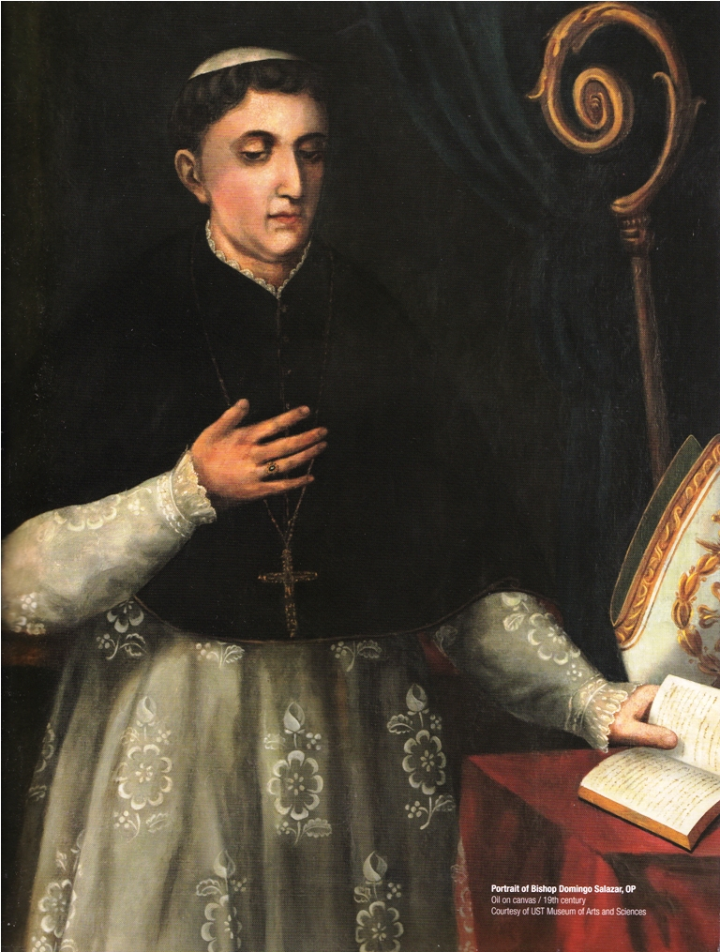
Customs of the Tagalogs Juan de Plasencia, O.F.M.
Notes:
It is considered as his most important work, being quoted, cited and even sometimes copied in its entirely by many later contemporary historians and writers

Slide 2
About the Author:
Fray Juan de Plasencia (real name is Joan de Portocarrero) is one of the seven children of Pedro Portocarrero.
He grew up in the region of Extremadura during the Golden Age (Siglo de Oro) of Spain.
During this period there was an upsurge of men entering religious life with the intention of suiting up for missionary works in the newly discovered territories.

Slide 3
Plasencia belonged to the Franciscan order and came together with the first batch of Franciscan missionaries who arrived in the Philippines on July 2, 1578.
He and Fray Diego de Oropresa were assigned to do mission works in Southern Tagalog area.

Slide 4
Aside from performing sacerdotal and missionary functions, Plasencia also helped in the foundation and organization of numerous towns in Quezon, Laguna, Rizal and Bulacan.

Slide 5
His continuous interaction with the people he converted to Christianity enabled him to write a book entitled Relacion de las Costumbres de Los Tagalos (Customs of the Tagalogs, 1589).
It vividly describes the political, social, economic and cultural practices of the Filipinos before they were Christianized.

Slide 6
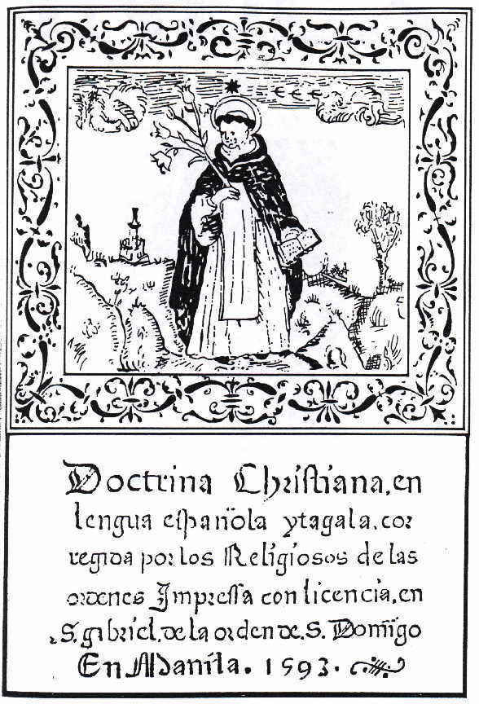
His biggest challenge at that time was how to make the articles of faith comprehensible to people who have never heard of Christ nor the Catholic Church.
In 1593, he published the book Doctrina Christiana en Lengua Espanola Y Tagala, the first printed book in the Philippines.

Slide 7
He used it as reading material for those Filipinos who wanted to deepen their faith in the newly accepted religion.
After several years of converting the natives and teaching catechism, the Franciscan Order honored him with the title "Venerable."
Plasencia died in Liliw, Laguna in 1590.

Slide 8
Historical Context:
During the first century of Spanish rule, colonial officials had the hard time running local politics because of the limited number of Spaniards who wanted to live outside Intramuros.
This situation forced them to allow Filipinos to hold the position of gobernadorcillo.

Slide 9
To ensure that they would remain loyal to the Crown, they instructed the friars assigned in the parishes to supervise and monitor the activities of the gobernadorcillo.
Hence, the friars ended up performing the administrative duties that colonial officials should have been doing in the local level.

Slide 10
They supervised the election of the local executives, helped in the collection of taxes, directly involved in educating the youth and performed other civic duties.
As years went by, the friars ended up the most knowledgeable and influential figure in the pueblo.

Slide 11
Some duties of friars assigned in mission territories:
inform periodically their superiors of what was going on in their respective assignments.
report the number of natives they converted, the people’s way of life, their socio-economic situation and the problems they encountered.
some submitted short letters while others who were keen observers and gifted writers wrote long dispatches.

Slide 12
On top of the regular reports they submit, they also shared their personal observations and experiences.
Plasencia’s Relacion de las Costumbres de Los Tagalos (Customs of the Tagalog, 1589) is an example of this kind of work.

Slide 13
It contains numerous information that historians could use in reconstructing the political and socio-cultural history of the Tagalog region.
His work is a primary source because he personally witnessed the events and observations that he discussed in his account.

Slide 14
There were other friars and colonial officials who wrote about the Filipinos that could further enrich our knowledge of Philippine history during the early part of the Spanish period.

Slide 15
Miguel de Loarca
Arrived in 1576 and became an encomendero of Panay.
He wrote Relación de las Islas Filipinas (1582) and his work described the way of life of Filipinos living in Western Visayas area.

Slide 16
Antonio de Morga.
He came to the Philippines in 1595 as Asesor and Teniente General.
His Sucesos de las Islas Filipinas gives us a lot of information about the state of the Philippines at the latter part of the 16th century.

Slide 17
Other Spanish missionaries who continued the historiographical tradition initiated by Loarca and Plasencia were:
Fr. Pedro Chirino S.J. (Relación de las Islas Filipinas, 1604;
Fr. Juan Delgado S.J. (Historia General, 1751);
Fr. Francisco Colin S.J. (Labor Evangelica, 1663);
Francisco Ignacio Alcina S.J. (Historia natural del sitio, fertilidad y calidad de las Islas e Indios de Bisayas, 1668); and
Fr. Joaquin Martinez de Zuniga O.S.A. (Historia, 1803).

Slide 18
Many of the what we know about Philippine history during the first century of the Spanish period were derived from the accounts of the Spanish friars.

Slide 19
About the Text:
The work of Plasencia is considered by many historians as an example of a friar account.
This kind of writing is one of the most common contemporaneous account during the early part of the Spanish period.

Slide 20
The original text of Plasencia’s Customs of the Tagalogs is currently kept in Archivo General de Indias (A.G.I.) in Seville, Spain.
There is also a duplicate copy of it in the Archivo Franciscano Ibero-Oriental (A.F.I.O.), in Madrid, Spain.

Slide 21
In the Philippines, an English version of it appeared in volume VII of the Blair and Robertson collections.
Another English translation of it was published as part of the volume for pre-Hispanic Philippines of the Filipiniana Book Guild series and what will be presented below is from this version.

Slide 22
Content Presentation and Analysis of the Important Historical Information Found in the Document

Slide 23
1. Community (Barangay, Dato, Three Castes)
2. Property
3. Marriage Customs
4. Worship (Religion)
12 Priests of the Devil
5. Superstition
6. Burying the Dead

Slide 24
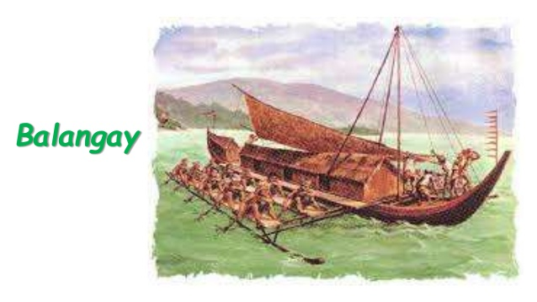
Community
Barangay – tribal gathering ruled by chiefs
It is called a “barangay” because they associate themselves with the “Malay” who are one of the first people to arrive in the Philippines through a boat in which they call “barangay”.
Some consisted of around 30 - 100 houses
Barangays also have some sort of diplomacy
All barangays were equal in terms of status

Slide 25
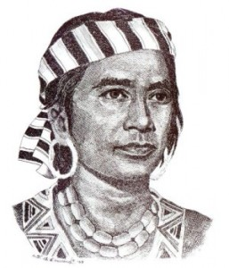
Datu
the chiefs of the village; they governed the people as captains even in wars, were obeyed, and revered; any subject who committed any offense against them, or spoke to their wives and children, were severely punished.

Slide 26
Social Hierarchy
There are three status/castes within a barangay: Maharlica, Aliping Namamahay, Aliping sa Guiguilir.
Maharlica are those who are born free;
Aliping Namamahay are those who serve their masters however, they can have their own properties
Aliping sa Guiguilir are those considered to be slaves who serve their masters or can be sold off.

Slide 27
Maharlica (nobles) | People who are born free Do not need to pay taxes Must accompany the datos in war
Aliping Namamahay (commoners) | They have their own properties but has to serve their own masters Children belonging to this caste inherit the status of their parents Cannot be treated as a slave nor can be sold off.
Aliping sa Guiguilir (slaves) | They serve their master in their houses and lands Can be sold off The master can reward his/her slaves by giving them a portion of the harvest so that the slaves would be faithful to him/her

Slide 28
Maharlica
He would keep their status for a lifetime however, this can be taken if he/she marries a slave.
In this case, the kids would be divided and they would inherit the status of their mother or father.

Slide 29
Property
The land area was divided among the whole barangay, especially the irrigated portions.
No one from a different barangay could cultivate land unless they inherit or buy the land
The lands on the tingues, or mountain ridges, are not divided but owned by the barangay as a whole.
At the time of rice harvest, any individual (regardless of their barangay) that starts to clear any land area may sow in it.

Slide 30
Property
Fisheries of chiefs had established limits, and sections of the rivers for markets
Unless you were a member of the chief’s barangay, you had to pay for the privilege of fishing or selling in the chiefs’ fisheries

Slide 31
Marriage Customs
In the case of a divorce, if the wife would leave her husband for the sake of marrying another man, all her belongings plus a certain amount would be given to her former husband however, if she chooses to leave and do not have any plans to marry, then all of her dowry will be returned to her.

Slide 32
In the case of an adoption, the children would receive double the value of how much they were bought to be adopted;
Investigations and sentences for the accused shall be presented and read in front of the tribe.

Slide 33
Worship and Belief (Religion)
There were no temples or sacred places in which Filipinos would worship
The word simbahan means a place to worship which is constructed at a large house of the chief where people of the tribe go to celebrate festivals (aka pandot or worship)
They beat large and small drums successively during the feast which usually lasted four days

Slide 34
Worship and Belief (Religion)
nagaanitos - worship; (anito - soul or spirit of ancestors)
sibi - a temporary shed, made on each side of the chief’s house, for the assembled people.
Bathala - one of their many idols, whom they specially worshipped.
They worshipped the sun, the moon, and some, even the stars or a particular dead man with special capability that fought bravely or protected them in their time of need

Slide 35
Worship and Belief (Religion)
sun - almost universally respected and honored because of its beauty;
moon - they would rejoice, especially when new
stars - they did not name them except for the morning star, which they called Tala
“Seven little goats” - the Pleiades; a star cluster
Balatic - the Greater Bear constellation
Mapolon - the change of seasons

Slide 36
Worship and Belief (Religion)
lic-ha - idols; images with different shapes;
Dian masalanta - an idol; patron of lovers and generation
Lacapati and Idianale - idols; patrons of the cultivated lands and husbandry;
buaya - crocodiles; were respected by the Tagalogs due to their fear of being harmed by them; they offered a portion of what they carried in their boats to them

Slide 37
‘12 Priests of the Devil’
Catolonan
Priest from a people of rank
Officiates the offering sacrifice for a feast and the food to be eaten being offered to the devil
Mangagauay
They pretend to heal the sick in order to deceive others
Manyisalat
They can cast remedies to couples for them to abandon one another

Slide 38
4. Mancocolam
Can emit fire from himself which cannot be extinguished
5. Hocloban
Much more powerful than a mangagauay in which they can kill anyone without the use of any medicine. They can also heal those who are ill.
6. Silagan
They would tear out and eat the liver of those they saw were wearing white

Slide 39
7. Magtatangal
They would go out at night without their heads and put it back into their bodies before the sun rise
8. Osuang
Tribesmen reported that they saw the “osuang” who can fly and murdered a man and ate his flesh.
9. Mangagayoma
They would seduce their partners with charms and other accessories so they can deceive them.

Slide 40
10. Sonat
This devil helped people to die. They can also know if the soul they helped to die can either be saved or not.
11. Pangatahojan
They can predict the future.
12. Bayoguin
These are men who are in the nature of a woman.

Slide 41
Placencia’s referred to certain ‘devil-ish belief’s e.g. the mangagauay and mangagayoma.
He regarded them both as “witches” who performed deceitful healing procedures, a judgment made by an outsider who knew nothing about the complexity of indigenous psyche.
What he failed to realize is that in traditional cultures, these so-called “evil” practices were an integral part of Filipino folk beliefs

Slide 42
Superstition
They find omens in events they witness
(i.e. when someone sneezed, met on their way a rat or serpent, or the Tigmamanuguin bird sang they would go home in fear that evil would befall them if they continued their journey)
The Tigmamanuguin bird’s (a blue bird as large as a turtle-dove) song had two forms: a good omen, and a bad omen.

Slide 43
Burying the Dead
In burying the dead, the corpse would be placed beside its house and be mourned at for 4 days.
It will then be laid on a boat which serves as a coffin which is guarded by a slave.
The grief of the relatives of the deceased is followed by eating and drinking.

Slide 44
Contribution and Relevance of the Document in Understanding of the Grand Narrative of Philippine History

Slide 45
Plasencia’s Customs of the Tagalogs is a very popular primary source because it vividly described the situation of the Philippines before it was tainted with Spanish and Christian influences.
Scholars like it because it covered numerous topics that are relevant in many disciplines.

Slide 46
Political scientists for instance find it useful because it contains a lot of information about the social classes, political stratifications and legal system of the Tagalog region.
Many of what we know about the duties and responsibilities of the datus, maharlikas and alipins came from Plasencia’s account.

Slide 47
Moreover, it also talks about property rights, marriage rituals, burial practices and the manner in which justice is dispensed.

Slide 48
Plasencia also preserved and popularized the unwritten customs, traditions, religious and superstitious beliefs of the Filipinos.
One can also say that our historical knowledge about the manananggal, aswang, hukluban, gayuma, etc. came from Plasencia’s works.

Slide 49
Priests and missionaries also read Plasencia’s Customs of the Tagalogs and Doctrina Christiana because they get a lot of insights that help and inspire them to become effective evangelizers.
One insight they got from Plasencia is the the realization that one needs to master the local language and study the culture of the people if you want to be a successful missionary.

Slide 50
They also learned from him that preaching should be accompanied with reading materials that contain the basic elements of faith.
These readings serve as their guide and reference when the missionaries are no longer around.
All these insights from Plasencia are applicable not only to missionaries but to other professions as well.

Slide 51
Plasencia’s historical writings also disprove the claim of some Spaniards that when they arrived in the Philippines, Filipinos were still uncivilized and lacking in culture.
It is clear in the excerpts quoted above that at the time Plasencia was assigned in the Tagalog region Filipinos were already politically and economically organized.

Slide 52
They have a functioning government, tax system, set of laws, criminal justice system, indigenous calendar and long-standing customs and traditions.
Moreover, they have already a concept of supreme being (Bathala), practiced burial customs and believed in life after death.

Slide 53
Lastly, Plasencia also mentioned that the people he met were wearing garments, gold ornaments and their houses were decorated with idols.
All of these lead to the conclusion that prior to the coming of the Spaniards, Filipinos were already civilized and maintained a lifestyle that was at par or even better than other countries in Southeast Asia.

Slide 54
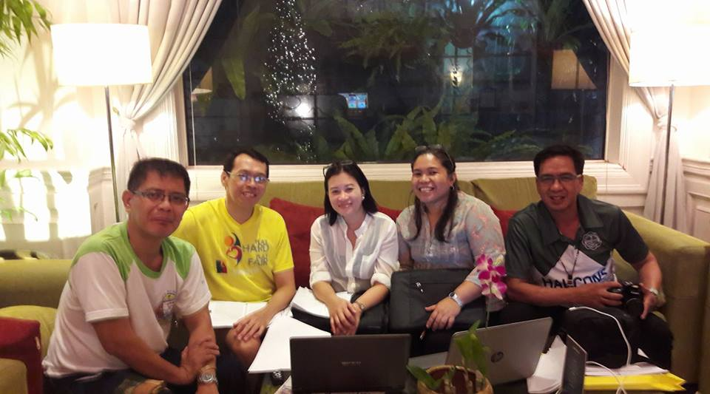
Thank You ☺

